Slide 1
University Submarkets
Investing in Homes Near Expanding Universities
San Diego case study: SDSU vs UCSD vs USD
Real Estate / REIT proposal
SDSU
UCSD
USD
Group 7
Stephanie Anshell (A18503005)
Jaevlyn Tanuwidjaja
Darwin Johan
Jon Dang
Collin Montenegro
Theme: university-bordering residential markets are concrete, researchable, and easier to defend with expansion plans, enrollment, transit access, rent support, and price history.
1
Notes:
[Sources] - Final Project prompt (user upload): /mnt/data/Final Project.pdf - Deck theme/style inspired by user uploads: example-presentation-1.pdf, example-presentation-2.pdf, example-presentation-3.pdf

Slide 2
Research Question & Why Universities
Why this topic is easier to defend than a broad speculative theme
Question
Which San Diego university-bordering housing submarket looks most attractive for a REIT: SDSU, UCSD, or USD?
University
expansion
Student demand
Neighborhood
housing demand
Why this framing works
Focus on signals we can actually document
Enrollment scale
Transit access
Official housing plans
Home values and rent support
Historical appreciation patterns
More concrete than climate-haven narratives: we can point to specific campuses, neighborhoods, and housing pipelines.
Official university plans make demand and supply changes observable instead of purely speculative.
Housing proxies are easy to compare across nearby ZIPs using rents, values, and historical price growth.
Bottom line: this topic gives a cleaner CEO pitch because both the thesis and the evidence are specific.
2
Notes:
[Sources] - Final Project prompt (user upload): /mnt/data/Final Project.pdf - Official UCSD long-range development plan: https://plandesignbuild.ucsd.edu/planning/lrdp/la-jolla.html - Official SDSU housing / Evolve project pages: https://housing.sdsu.edu/ and https://pdc.sdsu.edu/public-info-eir/eir - Official USD facts / transportation pages: https://www.sandiego.edu/about/usd-facts.php and https://www.sandiego.edu/commuter-commons/living-off-campus/transportation-and-parking.php

Slide 3
Market Definition & Data
Three campus-adjacent submarkets, using nearby ZIPs as practical proxies
School
Proxy area
Enrollment
Direct rail?
Net new beds
Avg home
value
Rent/
value
SDSU
College Area / 92115
39,000
Yes
4,468
$835k
6.18%
UCSD
University City / 92122
44,256
Yes
18,910
$1.073M
3.37%
USD
Linda Vista / 92110
9,714
No direct
stop
—
$989k
3.44%
Data used
Interpretation rule
Official university facts pages for enrollment, transit, and housing expansion plans.
Housing-market proxies from the nearby ZIP around each campus.
FHFA price-history outputs and 4.1 tract-level historical return summaries for robustness.
We are not claiming the ZIP is the exact campus boundary.
Instead, each ZIP is a transparent and replicable submarket proxy.
That makes the analysis easy to explain and update.
Proxy-based market definition keeps the story concrete: specific schools, specific nearby neighborhoods, specific expansion plans.
3
Notes:
[Sources] - User-provided dataset: /tmp/hw42deck/ucsd, sdsu, usd/outputs/tables/summary_table.csv - Official UCSD enrollment / planning / transit: https://ir.ucsd.edu/stats/undergrad/CDS_UCSD_2024-20252.pdf ; https://plandesignbuild.ucsd.edu/planning/lrdp/la-jolla.html ; https://transportation.ucsd.edu/campus/guide.html - Official SDSU enrollment / housing / transit: https://www.sdsu.edu/about/facts-mission-and-history ; https://housing.sdsu.edu/ ; https://parking.sdsu.edu/commuting/mts - Official USD facts / transit: https://www.sandiego.edu/about/usd-facts.php ; https://www.sandiego.edu/commuter-commons/living-off-campus/transportation-and-parking.php

Slide 4
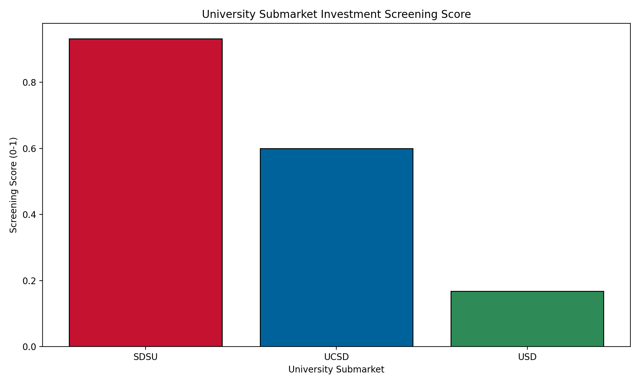
Screening Result: SDSU Ranks #1
A simple multi-factor screen points to SDSU as the best balanced entry market
Why SDSU comes out first
Lowest entry price of the three submarkets.
Strongest rent support: 6.18% annual rent-to-value ratio.
Direct Green Line stop on campus.
Meaningful housing pipeline: about 4,468 net new beds.
Large student base without UCSD-level acquisition cost.
Takeaway
SDSU is the cleanest “value + yield + access” play.
Score snapshot
SDSU 0.932 | UCSD 0.600 | USD 0.168
4
Notes:
[Sources] - User-provided chart: /tmp/hw42deck/ucsd, sdsu, usd/outputs/figures/investment_score_ranking.png - User-provided tables: /tmp/hw42deck/ucsd, sdsu, usd/outputs/tables/summary_table.csv and analysis_summary_table.csv - Scoring logic from user script: /tmp/hw42deck/ucsd, sdsu, usd/hw4.2.py

Slide 5
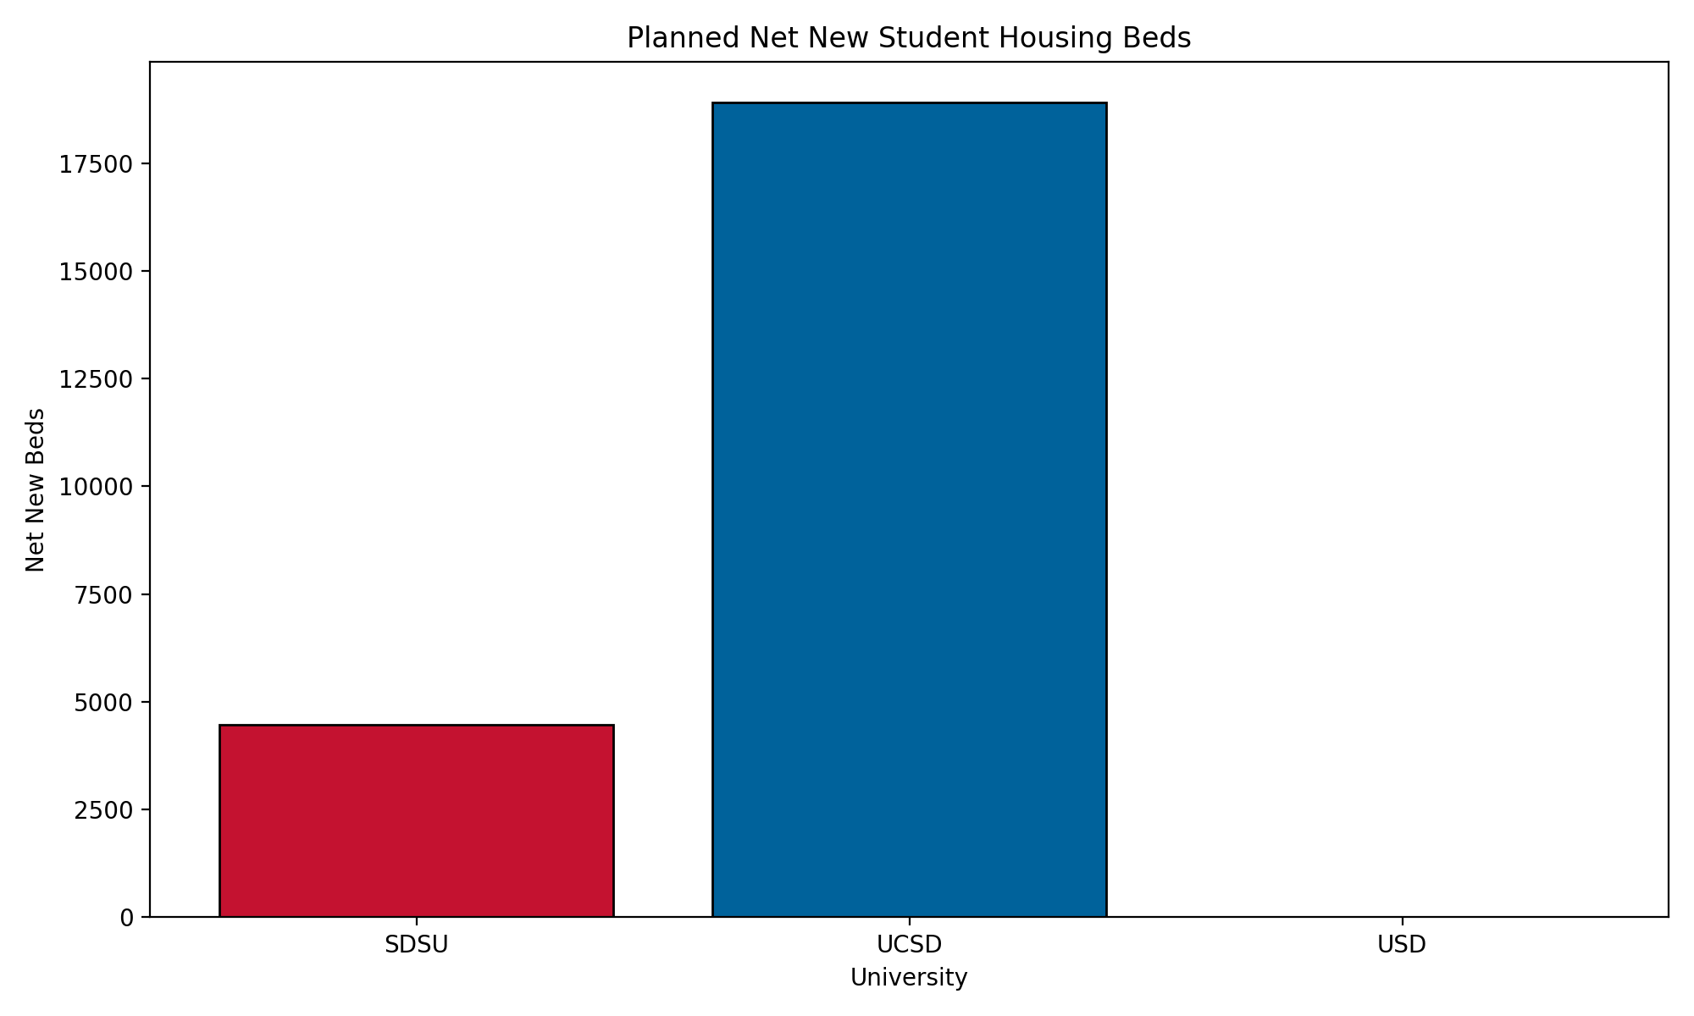
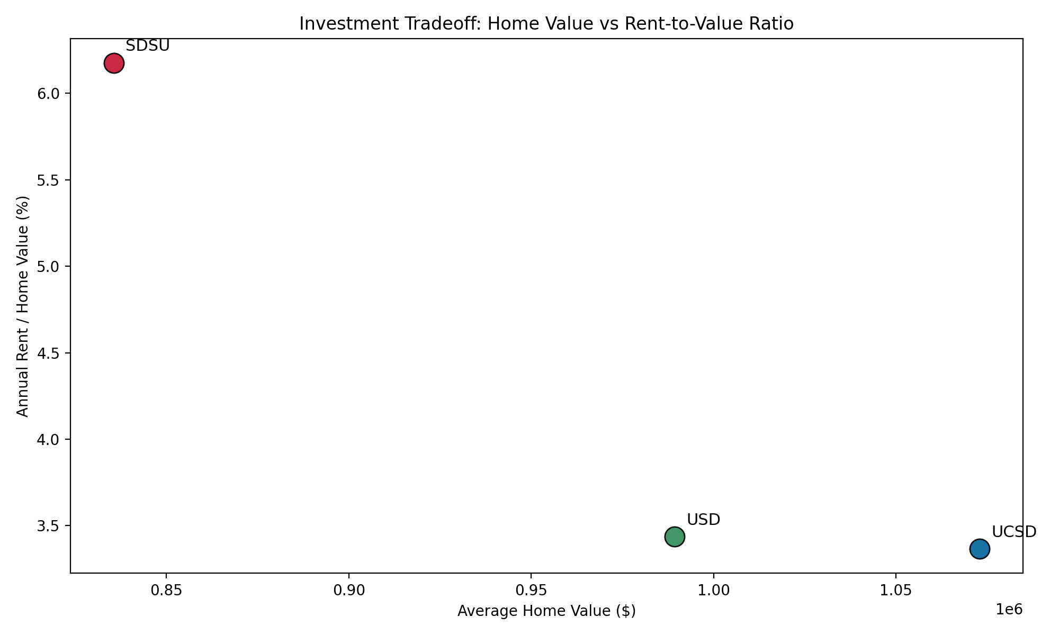
Why SDSU Leads: Better Yield at a Lower Entry Price
UCSD still matters because it has the biggest official expansion pipeline
Read the two visuals together
SDSU offers the highest yield with the lowest average purchase price.
UCSD is more expensive but has the strongest long-run official housing and campus-expansion story.
USD is useful as a benchmark, but the transit and expansion signal is weaker.
5
Notes:
[Sources] - User-provided charts: /tmp/hw42deck/ucsd, sdsu, usd/outputs/figures/value_vs_yield_scatter.png and expansion_housing_comparison.png - Official UCSD planning page: https://plandesignbuild.ucsd.edu/planning/lrdp/la-jolla.html - Official SDSU Evolve pages: https://housing.sdsu.edu/ and https://pdc.sdsu.edu/public-info-eir/eir - User-provided table: /tmp/hw42deck/ucsd, sdsu, usd/outputs/tables/summary_table.csv

Slide 6
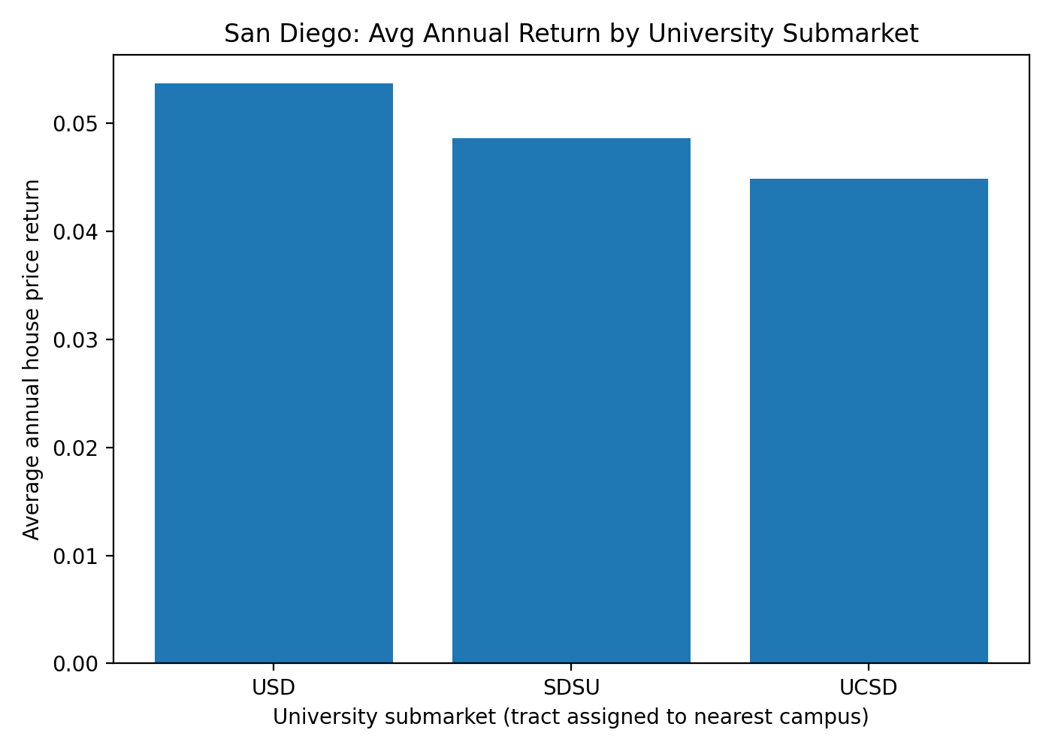
Historical Check from 4.1
Long-run house-price returns keep us from relying only on short-run current metrics
What the 4.1 evidence says
1990–2019 average annual tract-level returns: USD 5.37%, SDSU 4.86%, UCSD 4.49%.
Near-campus premium within 15 km: USD +0.82 pp, SDSU +0.63 pp, UCSD -0.06 pp.
So the historical evidence supports SDSU as a credible choice, even if USD ranks slightly higher on old returns alone.
Why this helps the story
We can say SDSU wins on today’s investability while also holding up reasonably well in the long-run historical record.
Best use in the presentation: a robustness slide, not the core ranking slide.
6
Notes:
[Sources] - User-provided chart: /tmp/hw41deck/hw4.1/sd_uni_comparison_bar.png - User-provided summary files: /tmp/hw41deck/hw4.1/sd_uni_submarket_summary.csv and sd_uni_near15km_premium.csv - User-provided script: /tmp/hw41deck/hw4.1/hw4.1.py

Slide 7
Recommendation, Risks, and How to Pitch It
Prioritize SDSU first, keep UCSD second, and use USD as a benchmark
SDSU first
Main risks to acknowledge
1
ZIPs are submarket proxies, not exact campus borders.
Official expansion can add supply as well as demand.
Some short-run price moves may be noisy, especially in a small comparison set.
A next version should add vacancy, renter share, and income data.
Best balance of affordability, rent support, transit access, and visible housing expansion.
UCSD second
2
More expensive, but strategically attractive because of campus scale and the largest official housing pipeline.
How to say it in class
“We are not claiming SDSU has the highest return on every possible metric. We are claiming it is the best balanced and most investable university-bordering submarket in this simple, defensible screen.”
USD benchmark
3
Useful comparison point; weaker direct rail and expansion signal makes it less compelling as the lead recommendation.
7
Notes:
[Sources] - Synthesis from user-provided tables and charts in hw4.1 and hw4.2 - Official UCSD planning / transit sources: https://plandesignbuild.ucsd.edu/planning/lrdp/la-jolla.html ; https://transportation.ucsd.edu/campus/guide.html - Official SDSU facts / housing / transit sources: https://www.sdsu.edu/about/facts-mission-and-history ; https://housing.sdsu.edu/ ; https://parking.sdsu.edu/commuting/mts - Official USD facts / transit sources: https://www.sandiego.edu/about/usd-facts.php ; https://www.sandiego.edu/commuter-commons/living-off-campus/transportation-and-parking.php

Slide 8
Conclusion
Recommended geographic market: homes in the SDSU and UCSD university submarkets
Final recommendation
A REIT should prioritize university-bordering residential submarkets near SDSU first and UCSD second, using USD mainly as a benchmark.
SDSU
UCSD
USD
Best overall screen:
lower entry price, strongest yield, direct trolley access, and visible expansion.
Second choice:
most strategic expansion pipeline, but weaker affordability and rent support.
Benchmark only:
historical returns are solid, but the broader investability story is weaker.
Core message for the CEO: university submarkets are a disciplined way to find concrete real-estate opportunities and SDSU is the clearest first bet in San Diego.
8
Notes:
[Sources] - Conclusion synthesized from user-provided hw4.1 and hw4.2 outputs - Supporting official sources listed in prior slide notes (UCSD, SDSU, USD facts / planning / transit pages) - Historical support from /tmp/hw41deck/hw4.1/sd_uni_submarket_summary.csv and sd_uni_near15km_premium.csv

